Slide 1


Architecture & Systems Engineering
Week 3: System Architecture
Project Portfolio
Name
Tomas Mawyin

Slide 2
Instructions
Before you begin, you should save your Project Portfolio on your local drive. We recommend the following format:
Lastname_Firstname_Course1_Week3
Please note: You will not be able to re-download your file after submission; therefore, please keep this file in a central location for future reference.
While you may be working with a group, the project deliverable is an individual submission. A scoring rubric can be downloaded from the course in the Resources/Downloads tab on the top navigation.
This week, you will be self-assessing your work as well as the work of three peers in the class. If you have any questions, feel free to start a thread in the Discussion Forum. Although work is strictly individual, sharing ideas and concepts with other students is encouraged.
Note: edX has a 10MB file size limit for document submission. If you have selected large image(s), you may need to resize before submitting, OR you may simply include a web URL for the image in the image location. Be sure to submit your assignment at least one hour before the deadline to provide time for troubleshooting.
Once the deadline passes, you will not be able to upload the document and therefore will not be able to submit and complete the assignment.
Peer Feedback is limited to 300 characters.

Slide 3
Week 3 Project
Overview
In the third project activity of this course, your team will build on a specific project of your own choosing – such as the last system you worked on, or a system from a previous project. Please ensure that the system has at least a medium (but preferably high) level of complexity -- such as a car, satellite, an enterprise server, or an open-source software.
Note that some Scratch Pages are included at the end of the project document for you to capture any ideas, sketches, etc. that you may have as you work through the project. These will not be assessed and you are not required to submit them with your project (but you may do so if you think they offer any additional insight into your thinking process!).
REQUIRED STEPS:
Step 1: Select your system for this project.
Step 2: Produce a solution-neutral function and concept.
Step 3: Develop and analyze a set of architectural decisions.
Step 4: Review and submit your project.

Slide 4
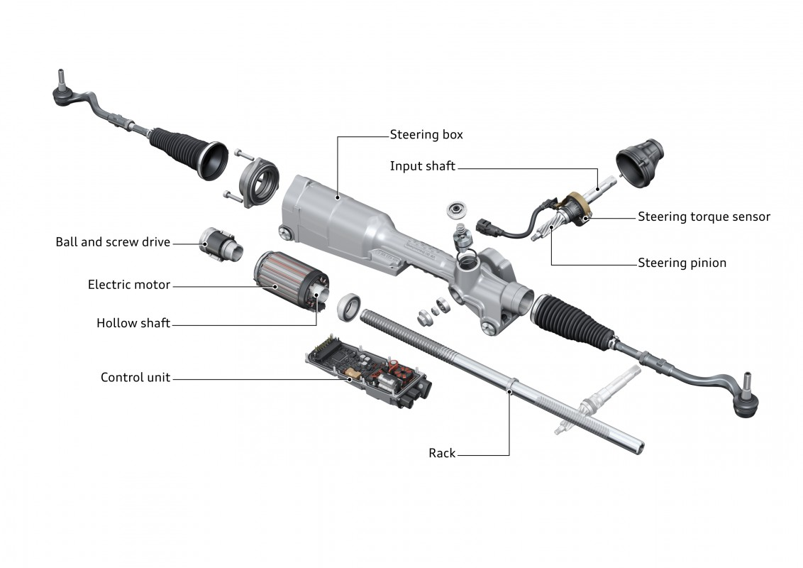

STEP 1: SYSTEM SELECTION
As a group, select a system for your project. Please ensure that (1) at least one team member is knowledgeable about the system, (2) the system has a medium to high level of complexity and (3) group members feel comfortable analyzing the system. Some systems of medium to high complexity include: a car, a satellite, an enterprise server or an open source software such as apache spark.
Please remember the file size limit and resize or paste the image URL instead, as needed.
Name of System:
Electronic Rack & Pinion Steering System
System Image/Diagram/Schematic View of Form
Insert diagram of your selected system here.
Ref: https://www.audi-technology-portal.de/en/chassis/wheel-suspension-steering/power-steering

Slide 5
STEP 2A: SOLUTION-NEUTRAL FUNCTIONS
For the system you selected, provide a possible hierarchy, containing at least three levels, of the solution neutral to solution specific functions. The focus of this diagram is processes. For your system illustrate a range of processes from more solution neutral (like “accessing”) to more solution specific (like ”pushing”). It may be helpful to refer to the Wine Bottle System example in the video and to the sample project. You may also illustrate the operand (s) on this diagram (e.g. cork, bottle, wine), but do not illustrate the forms associated with each process.
Please remember the file size limit and resize or paste the image URL instead, as needed

Slide 6
STEP 2B: FORMS
For the solution-neutral functions produced in step 2A, develop a set of possible forms that could be used. For example, in the Wine Bottle Example if you chose “Cork Removing”, now illustrate several forms by which you could accomplish this – Cork Suctioning Using a Vacuum Device, Cork Pulling Using a Corkscrew, etc. Mark your selected concept by drawing a system boundary around the selected function and form.
Please remember the file size limit and resize or paste the image URL instead, as needed.

Slide 7
STEP 3A: ARCHITECTURAL DECISIONS
For your system develop a set of architectural decisions (minimum of 5) keeping in mind that such decisions must be highly connected and/or sensitive to the key stakeholder metrics. Provide a rationale for the decision and two options/alternatives.
Architectural decision | Rationale | Option(s)
Road loads | Sizing of the steering pinion, rack, and mechanical components depend on road loads | High loads (bigger size vehicles) Low loads (smaller size vehicles)
Material | Material selection will affect weight of the system which could affect vehicle efficiency | Steel Aluminum
Steering Feel (Dynamics) | Provide a feeling to the driver by adjusting steering ratio, friction, or compliance | Sport mode Comfort mode
Handedness of Vehicle | Defines which side of the vehicle attaches to the steering wheel | Left hand driving Right hand driving
Added electronic features | Provides the driver with additional comfort options | Lane Keep Assist Lane Centering Assist Auto Parking
Motor Size | Motor size help determine what kind of power is available to assist the driver during steering maneuvers | High Power Medium Power Low Power
Attachment Points | Dictates some of the geometry of the system by defining attachment to the subframe and knuckle (wheels) | Front attachment Rear attachment
Electronic Components | This will affect what kind of communication and capability is possible for the electronics | Different type of micro-controllers and sensors
Sealing and Environmental Management | Understanding the effect of environment on the system | Fully Sealed Breathable

Slide 8
STEP 3B: ARCHITECTURAL DECISIONS
For the set of architectural decisions developed in the step 3A, classify them by highly coupled/sensitive decisions in the matrix given below. We want you to actively classify these decisions, not automatically place all of them in the High Sensitivity / Highly Coupled box.
 | Loosely Coupled | Highly Coupled
High Sensitivity | - Steering Feel - Attachment Points | - Road Load - Motor Size - Left or Right Handed
Low Sensitivity | Electronic Components Added Electronic Features | Material Sealing & Environmental Management

Slide 9
STEP 3C: ARCHITECTURAL DECISIONS
For the set of architectural decisions developed, include a small write-up with constructive feedback that touches on the following. Do these decisions represent the architecture of the system? Are they true architectural decisions?
Please remember the file size limit and resize or paste the image URL instead, as needed.
The main architectural decisions for the steering system are the road loads, the motor size, and the handedness of the vehicle (i.e., left-hand or a right-hand drive). These decisions were selected because they are crucial to the design of this system. The road loads, for example, determine the size of the rack and pinion and how durable the meshing between them should be. The motor size is used to determine how much assist the system can provide to the driver. Similarly, the left or right configurations affect the construction and manufacturing of the system. Together, these architectures determine the difference between the steering system for a truck or a small passenger sedan. Furthermore, these decisions are highly connected – they affect the entire downstream process from design to manufacturing, and are also highly sensitive – they make possible the correct sizing of the components that affect fuel efficiency.
Decisions about steering feel and attachment points to the vehicle are highly sensitive because they can change the driving comfort by affecting the friction or compliance of the system. Steering feel, for example, is related to the maximum turning circle, which helps when making tighter turns. The attachment points help reduce noise and vibrations to make the ride feel comfortable to the driver. In general, these decisions are less connected because other components (e.g., bushings) can be also be added to adjust the feel of the system.
Decisions about material and sealing management are highly connected because they influence build techniques and manufacturing decisions. Changing these later in the design process can have a costly effect on the system.
Electronic components and added features are not critical architectural decisions because they do not directly influence the design of the system. Instead, they are independent to the design and can be changed, added or removed without compromising the system integrity.

Slide 10
STEP 4: REVIEW & SUBMIT PROJECT
Submit your completed Week 3 Project Portfolio file
Complete Self-Assessment of Project
Complete the Peer Assessments of Project (Peer assessment is limited to 300 characters) Note: The maximum file size that can be submitted is 10MB.
A sample project submission and scoring rubric can be downloaded from the course in the Resources/Downloads tab on the top navigation.
Please remember that there are three steps to this assignment: Submission, peer assessment, and self assessment. Please provide enough time by each deadline to complete your assignment on time, as it is not possible to submit once the submission window closes.

Slide 11
Scratch Pages*
Reminder: edX has a 10MB file size limit for document submission. If you have selected large image(s), you may need to resize before submitting, OR you may simply include a web URL for the image in the image location. Be sure to submit your assignment at least one hour before the deadline to provide time for troubleshooting
Please remember the file size limit and resize or paste the image URL instead, as needed.

Slide 12
Scratch Pages*
Reminder: edX has a 10MB file size limit for document submission. If you have selected large image(s), you may need to resize before submitting, OR you may simply include a web URL for the image in the image location. Be sure to submit your assignment at least one hour before the deadline to provide time for troubleshooting
Please remember the file size limit and resize or paste the image URL instead, as needed.

